Slide 1
Mapping a Trusted Path to VGI
Bernard Roper
b.a.roper@soton.ac.uk
University of Southampton
WAIS Group
Adriane Chapman
University of Southampton
WAIS Group
David Martin
University of Southampton
Geography and Environment
Stefano Cavazzi
Ordnance Survey

Slide 2
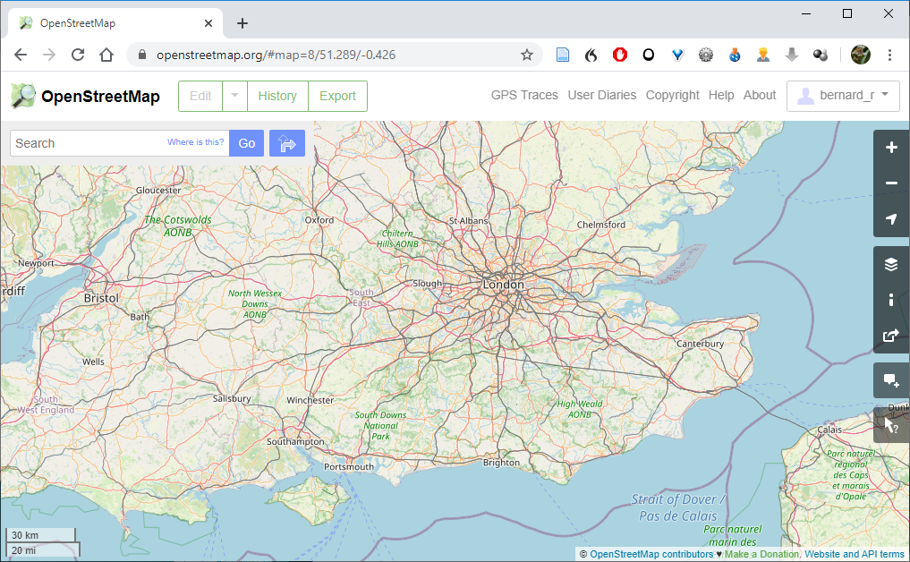
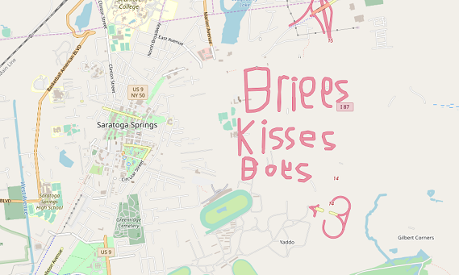
Mapping a Trusted Path to VGI
OpenStreetMap is the most extensive geographic dataset ever made, but can you trust it?
Notes:
Osm vgi background
Maturity

Slide 3
maturity
/məˈtʃʊərəti/
Noun
An advanced stable state in which the only reason for editing is to reflect real-world change.

Slide 4
Linus’s Law Maturity
A measure of how many people have “seen” a feature. It is characterised by the open source maxim, “many eyes make bugs shallow”
Edit Count: Number of versions of an OSM data primitive within a grid cell normalised by the number of primitives Editor Count: The number of prov:Agents who influenced data within the cell.
Average editors per feature: the number of agents who have edited any version of the feature or any child features of that feature divided by the number of features in the cell.
Average edits per feature: the number of feature versions divided by the number of features.
Currency
A measure of how recently editing activity has taken place, and how “up to date” data is.
Days since last update: The difference between the timestamp of the most recent version of a data primitive within the cell, and now.
Average days since Last Update: The average difference between the timestamp of the most recent version of all primitives within the cell
New Edits: the number of edit versions within a cell with timestamps within one months of the download date High values indicate high maturity
Life-cycle Maturity
Changes in edit frequency over the life-cycle of data have been studied in Wikipedia and OSM, where the most mature data has a stable phase after a period of more intense activity.
Life-Cycle Edits: The number of edits that occurred in the last 20% of an artefact’s lifetime divided by the total edits.
Volatility
A measure of the rate at which edits are retained. It is calculated by counting the number of tags which are changed and then reverted to their previous state. A tag revert is defined as a tag (a feature attribute) is edited and then returned to its previous state in a subsequent edit.
Tag Revert Count: The number of tag reverts in a cell.
Revert Rate: the average number of tag reverts per feature
Transient Edit ratio derived from the number of edits to tags reverted to their previous state within one month
Maintenance Edit Ratio
A maintenance edit is defined as any edit to data that occurs after its creation, i.e. resulting in a version number greater than 1..
Maintenance ratio: the number of Maintenance Edits in a cell divided by the number of Creation Edits in that cell.

Slide 5
OSM XML History data
XSLT
RDF/XML triples
GeoSPARQL
Geographic VGI provenance
SPARQL
Maturity Values
The geometry used to extract provenance data
Example GeoSPARQL Query for geographic provenance extraction

Slide 6
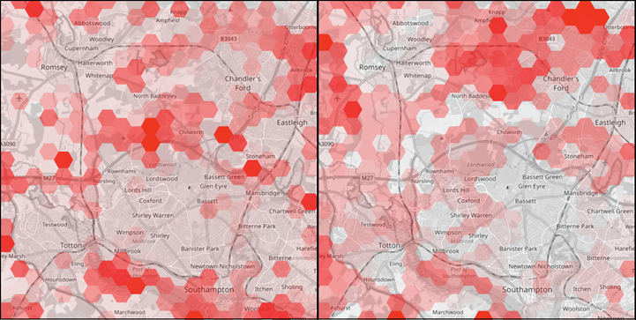
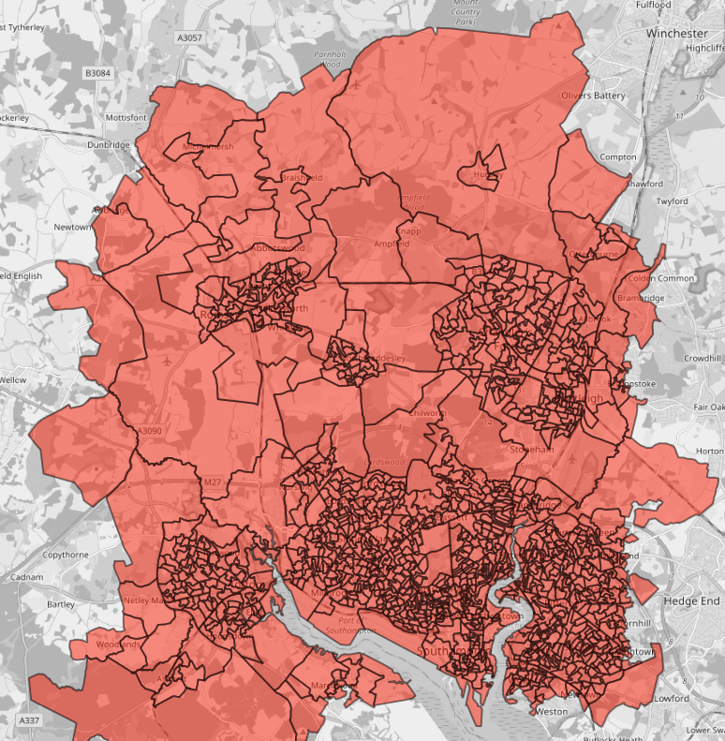
Mapping a Trusted Path to VGI
Maps of the study area using hexagonal grid cells, showing the distribution of Maintenance Ratio (left), and Currency as days since last update (right).
Map of the study area with census output geometry
Bernard Roper: b.a.roper@soton.ac.uk

